Slide 1
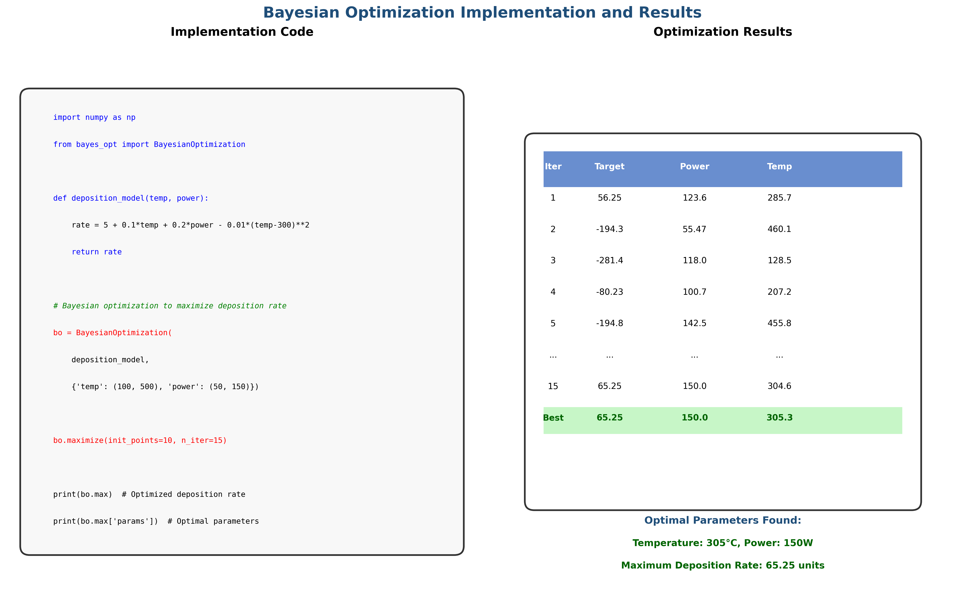
Bayesian Optimization Code and Analysis

Slide 2
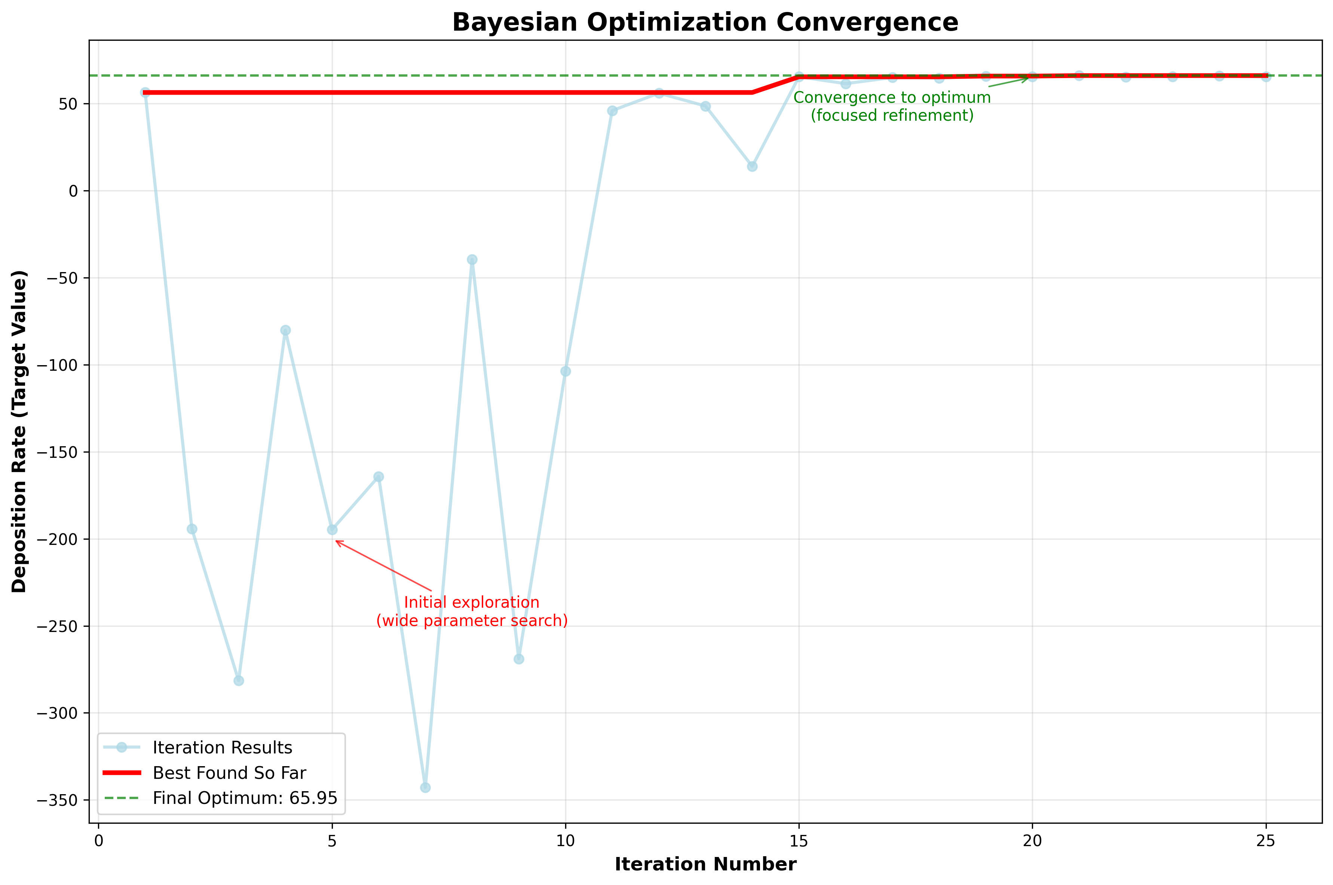
Optimization Convergence Analysis

